Slide 1
Predictive Modeling for Disease Diagnosis: Integrating Medical Data Analysis
Submitted in the partial fulfillment for the award of the degree of
BACHELOR OF ENGINEERING
IN
Artificial Intelligence and Machine Learning
Submitted by:
Shreshth Sahay
21BCS5409
B.Venu Gopal Reddy
21BCS5361
Under the Supervision of:
Mr. Prabhjot Singh Bali
Department of AIT-CSE
DISCOVER . LEARN . EMPOWER

Slide 2
Outline
Introduction to Project
Problem Formulation
Objectives of the work
Methodology used
Results and Outputs
Conclusion
Future Scope
References

Slide 3
Introduction to Project
Project Overview:
The project, titled "Predictive Modeling for Malaria Diagnosis," aims to develop an advanced computational model for accurate and efficient diagnosis of malaria.
Problem Statement:
Malaria remains a significant global health challenge, with existing diagnostic methods facing limitations in accuracy, accessibility, and efficiency.
Objectives:
The primary objective is to develop a predictive modeling system that enhances the accuracy and accessibility of malaria diagnosis, particularly in resource-constrained settings.
Significance of the Project:
Improved malaria diagnosis can lead to timely intervention, reduced morbidity and mortality rates, and better allocation of healthcare resources.

Slide 4
Introduction to Project
Approach:
The project employs machine learning algorithms and advanced data analysis techniques to develop predictive models for malaria diagnosis.
Expected Outcomes:
Anticipated outcomes include improved diagnostic accuracy, enhanced efficiency, and increased accessibility to reliable malaria diagnosis.

Slide 5
Scope of the Project
Project Focus:
The project focuses on developing a predictive modeling system for malaria diagnosis, leveraging advanced computational techniques and machine learning algorithms.
Key Components:
The scope includes data collection, preprocessing, feature engineering, model development, validation, and integration with existing healthcare systems.
Data Sources:
Diverse medical data sources will be considered, including clinical records, laboratory test results, and demographic information related to malaria cases.
Geographical Scope:
The project aims to address malaria diagnosis challenges across various geographic regions, with a focus on regions with high disease burden and limited healthcare resources.

Slide 6
Scope of the Project
Technological Scope:
The project utilizes state-of-the-art machine learning algorithms, statistical methods, and data analysis techniques to develop accurate and efficient predictive models for malaria diagnosis.
Interdisciplinary Collaboration:
Collaboration with healthcare professionals, researchers, data scientists, and policymakers is essential to ensure the project's success and relevance in real-world healthcare settings.
Ethical Considerations:
Ethical considerations, including patient privacy, data security, and informed consent, are paramount throughout the project lifecycle.
Limitations:
The scope of the project may be constrained by factors such as data availability, computational resources, and regulatory requirements.
Future Extensions:
The project lays the foundation for future research and development in areas such as disease surveillance, treatment optimization, and personalized healthcare.

Slide 7
Planning for Implementation
Project Phases:
The implementation plan is divided into several key phases, including data collection, model development, testing, deployment, and maintenance.
Data Collection:
Collect diverse medical data sources relevant to malaria diagnosis, ensuring data quality and compliance with regulatory standards.
Model Development:
Develop predictive models using machine learning algorithms and advanced data analysis techniques, optimizing for accuracy and efficiency.
Testing and Validation:
Test the developed models using independent datasets and validation techniques to assess their performance and generalization capability.

Slide 8
Planning for Implementation
Deployment:
Deploy the validated models into production environments, ensuring scalability, reliability, and seamless integration with existing healthcare systems.
Maintenance and Updates:
Implement mechanisms for ongoing maintenance, monitoring, and updates to the deployed models, adapting to evolving data distributions and clinical practices.
Evaluation Metrics:
Define evaluation metrics such as sensitivity, specificity, accuracy, and area under the curve (AUC) to assess the performance of the implemented models.
Stakeholder Engagement:
Engage stakeholders including healthcare professionals, researchers, and policymakers throughout the implementation process to gather feedback and ensure alignment with user needs.

Slide 9
Planning for Implementation
Ethical Considerations:
Adhere to ethical guidelines and regulatory requirements regarding patient privacy, data security, and responsible use of technology throughout the implementation phase.
Resource Allocation:
Allocate resources including personnel, infrastructure, and funding effectively to support the implementation activities and ensure project success.
Documentation and Training:
Document implementation processes, procedures, and outcomes comprehensively, and provide training to relevant stakeholders to facilitate adoption and usage of the implemented models.

Slide 10
Feature/characteristics Identification
EfficientNet:
Known for its deep architecture with residual blocks.
Addresses the vanishing gradient problem, enabling training of very deep networks.
Suitable for complex image recognition tasks due to its deep layers.
Provides higher accuracy compared to traditional deep networks.
Widely used in various computer vision applications.

Slide 11
Feature/characteristics Identification
Inception ResNet:
Combines the Inception module from GoogLeNet with residual connections.
Utilizes multi-scale feature extraction through the Inception module.
Integrates residual connections for efficient training and improved performance.
Offers a good balance between accuracy and computational efficiency.
Effective for tasks requiring both high accuracy and fast inference.

Slide 12
Feature/characteristics Identification
MobileNet:
Designed for mobile and embedded devices with limited computational resources.
Employs depthwise separable convolutions to reduce model size and computation.
Provides a lightweight and efficient architecture without compromising performance significantly.
Suitable for real-time applications and deployment on devices with resource constraints.
Offers a trade-off between model size, inference speed, and accuracy.

Slide 13
Constraint Identification
Computational Resources:
Limited computational resources, especially for deployment on mobile and embedded devices.
Constraint on model complexity and size to ensure efficient inference.
Data Availability and Quality:
Availability of labeled data for training the transfer learning models.
Ensuring data quality and relevance for accurate model training.
Transfer Learning Adaptability:
Compatibility of transfer learning techniques with the selected models.
Constraint on the transferability of features across different datasets and domains.
Training Time and Iterations:
Time constraints for model training and optimization, especially for large datasets.
Iterations required for fine-tuning the pre-trained models to the specific task of malarial cell detection.

Slide 14
Constraint Identification
Performance Metrics and Evaluation:
Selection and evaluation of appropriate performance metrics (e.g., accuracy, sensitivity, specificity) for malarial cell detection.
Ensuring robustness and generalization of the models across different test scenarios.
Model Interpretability and Explainability:
Constraint on model interpretability, especially for healthcare applications requiring explainable AI.
Methods for interpreting and explaining model predictions for clinical validation and decision-making.
Deployment Environment:
Constraints related to the deployment environment, such as network connectivity, storage limitations, and real-time processing requirements.
Compatibility with existing healthcare systems and infrastructure for seamless integration.

Slide 15
Analysis of Features and Finalization Subject to Constraints
EfficientNet:
Features:
Deep architecture with residual blocks captures intricate features in malarial cell images.
Suitable for complex patterns and variations in cell morphology.
Offers high accuracy but may require significant computational resources and training time.
Constraints Consideration:
Ideal for high-performance systems with ample computational resources.
Requires careful resource allocation and training optimization due to its deep structure.

Slide 16
Analysis of Features and Finalization Subject to Constraints
Inception ResNet:
Features:
Combines multi-scale feature extraction from Inception modules with the efficiency of residual connections.
Captures both local and global features effectively, balancing accuracy and computational efficiency.
Constraints Consideration:
Preferred for resource-constrained environments due to its efficiency.
Offers good accuracy without excessive computational demands, suitable for real-time processing.

Slide 17
Analysis of Features and Finalization Subject to Constraints
MobileNet:
Features:
Lightweight architecture with depthwise separable convolutions for efficient computation.
Maintains reasonable accuracy while reducing model size and inference time, ideal for mobile deployment.
Constraints Consideration:
Well-suited for deployment on mobile devices and resource-constrained environments.
Provides a trade-off between model size, accuracy, and computational efficiency.

Slide 18
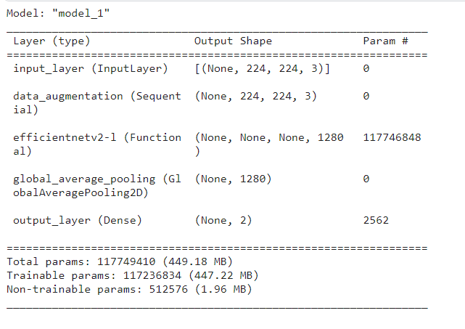
Design Selection
EfficientNet:

Slide 19
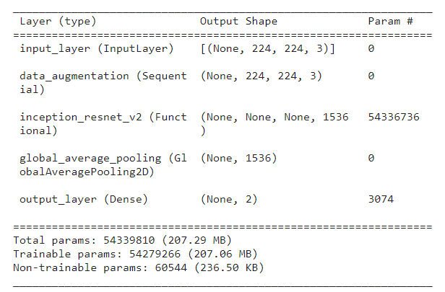
Design Selection
Inception ResNet:

Slide 20
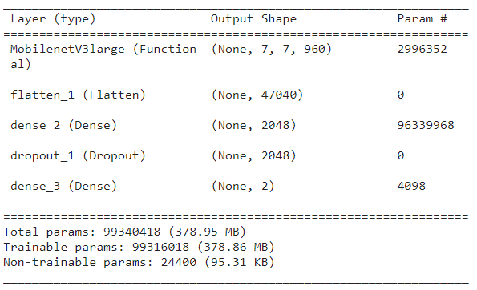
Design Selection
MobileNet:

Slide 21
Objectives of the Work
High Accuracy: Achieve precise detection of malaria cells on slides for reliable diagnoses.
Automation: Implement AI-driven systems for automated malaria cell prediction to minimize manual efforts.
Scalability: Develop methods adaptable to diverse healthcare settings for widespread use.
Resource Efficiency: Optimize computational resources and time for cost-effective screening.
Collaboration: Foster interdisciplinary teamwork to ensure robust and clinically relevant solutions.

Slide 22
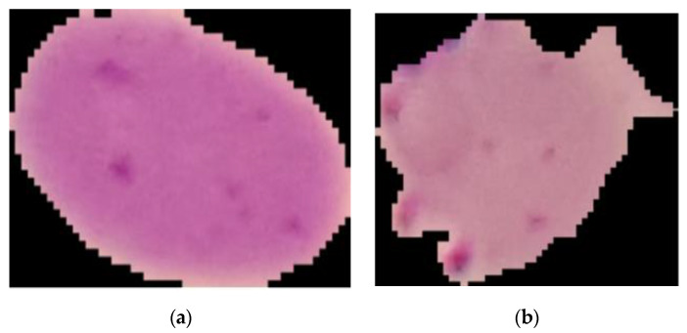
Methodology used
DATASET:
Research used graphic data to develop CAD system for efficient malaria identification, reducing time and burden on medical professionals.
Graphic data used to develop CAD system for efficient malaria identification, reducing time and burden on medical professionals. Dataset included 201 patients' samples.

Slide 23
Methodology used
Preprocessing:
1. Dataset Creation:
- Create training and validation datasets from a directory of images using TensorFlow's `image_dataset_from_directory`.
- Configure categorical labels and define image size and batch size.
2. Data Augmentation Pipeline:
- Define a sequential data augmentation pipeline including random flip, rotation, zoom, contrast adjustment, and Gaussian noise.
3. Training Data Generation:
- Generate training data with specified augmentation techniques to enhance model robustness and generalization.
4. Validation Data Generation:
- Generate validation data from the same directory with a subset for validation.
- Ensure validation data remains distinct from training data to evaluate model performance effectively.

Slide 24
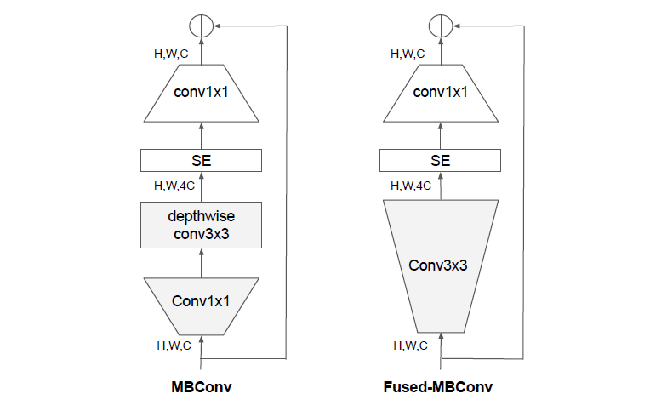
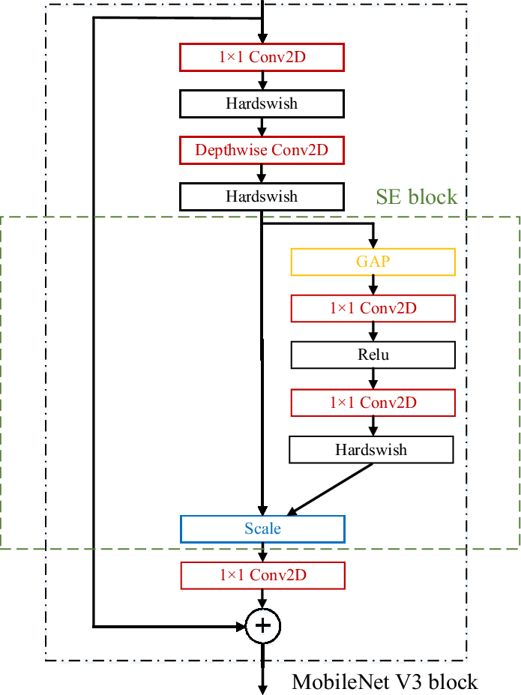
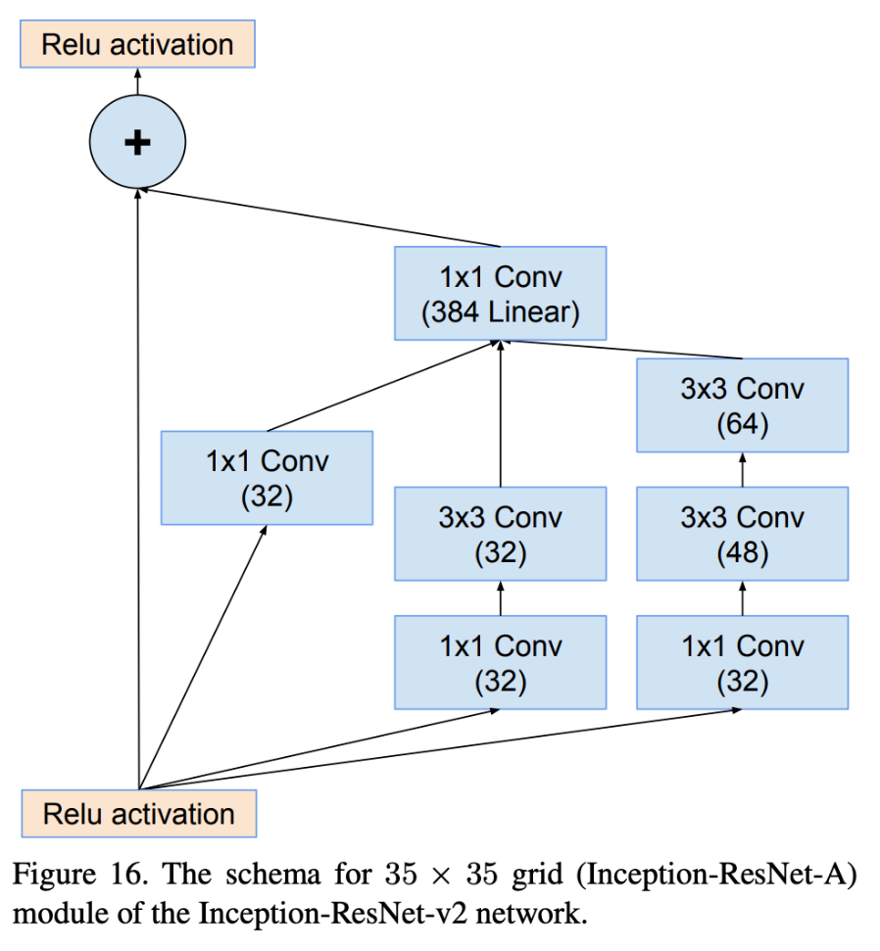
Methodology used
FLOWCHART OF MODELS:
MobileNetV3L
InseptionResnet
EfficientNet V2L

Slide 25
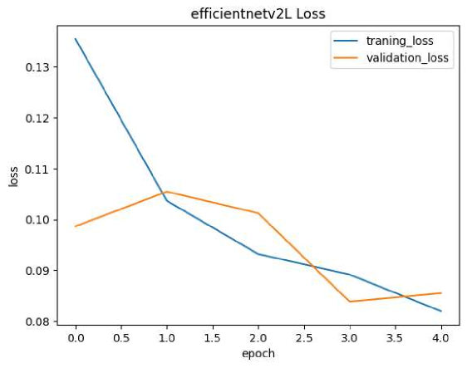
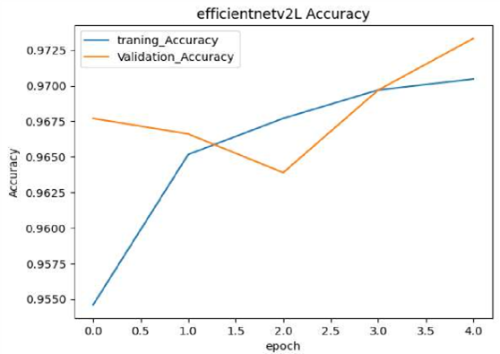
Results and Outputs
EfficientNetV2L:
fig(X,Y):EfficientNetV2L Accuracy and Loss

Slide 26
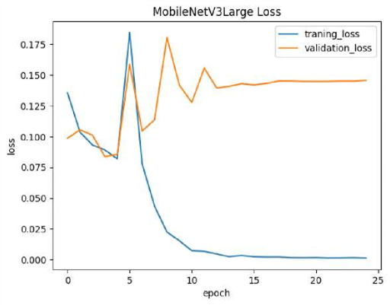
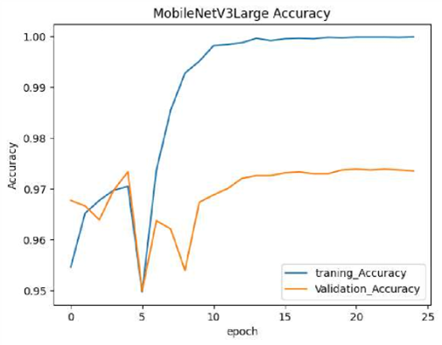
Results and Outputs
MobileNetV3Large:

Slide 27
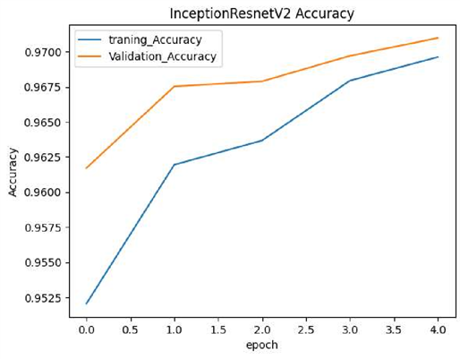
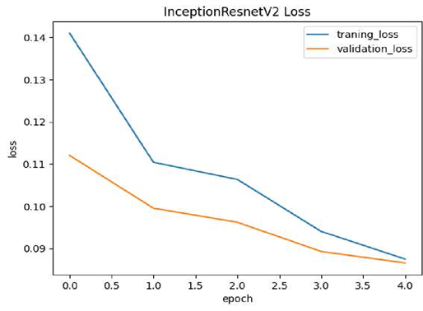
Results and Outputs
InceptionResNetV2:

Slide 28
Conclusion
1. Introduction to Diagnostic Trends:
- Embraces CNNs in diagnostics for precise malaria detection from cell images.
2. Utilization of Extensive Dataset:
- Employed 27,558 red blood cell images to showcase deep learning's capability in innocent cell identification.
3. Power of Deep Learning in Medical Imaging:
- Recognizes deep learning's potential in medical imaging akin to cancer detection.
4. Revolutionary Automated Diagnostic System:
- Concludes the development of an automated diagnostic system as a revolutionary advancement, particularly impactful in resource-limited areas.
5. Enhanced Accuracy and Efficiency:
- Affirms the potential of the system to significantly elevate diagnostic accuracy and efficiency, especially in underserved regions.

Slide 29
Future Scope
Enhanced Precision: Further refine deep learning models to achieve even higher precision in malaria cell detection, reducing false positives and negatives.
Real-Time Diagnosis: Develop real-time diagnostic tools leveraging mobile or web-based applications for instant malaria screening, enabling prompt treatment and intervention.
Remote Healthcare: Extend the application of automated diagnostic systems to remote or rural areas lacking access to specialized medical facilities, facilitating early detection and management of malaria.
Integration with Healthcare Systems: Integrate the malaria cell prediction system with existing healthcare systems, Electronic Health Records (EHR), and telemedicine platforms to streamline workflow and enhance patient care.

Slide 30
References
[1] IEEE Engineering in Medicine and Biology Society's 38th Annual International Conference in 2016 held in Orlando discusses advancements in medical technology.
[2] The 2019 IEEE International Conference on Communication and Signal Processing, organized by Adhiparasakthi Engineering College and the IEEE Madras Section, aimed to foster discussions on communication and signal processing innovations.
[3] Rahman et al. (2021) conducted a comparative analysis of deep learning architectures for malaria parasite classification using a high variation dataset.
[4] Kudisthalert et al. (2020) proposed a method for counting and classifying malarial parasites from Giemsa-stained thin film images.
[5] Moon et al. (2013) developed an image analysis algorithm for malaria parasite stage classification and viability quantification.

Slide 31
References
[6] Minarno et al. presented a study on malaria cell image classification using the Inception-V3 architecture.
[7] Jain et al. (2020) utilized deep convolutional networks for cell image analysis to detect malaria.
[8] Tian et al. discuss proceedings from the 2016 IEEE International Conference on Bioinformatics and Biomedicine held in Shenzhen, China.
[9] Krishnan et al. (year) focused on visualizing deep learning activations to enhance malaria cell classification.
[10] Hassan et al. (2022) proposed a novel convolutional neural network model for classifying malaria cell images.
[11] Reddy et al. (year) explored malaria cell image classification using the InceptionV3 architecture and SVM.

Slide 32
Thank you

